Slide 1
OP 21 Revised Marine Budget VS Vessel Demand Management Framework
January 2021
LOGISTICS TEAM

Slide 2
Objective & Outcome
Agenda
Transform Logistics Steerco Decision on “Marine common cost budget” management - Notify key stakeholders
Share Case for change and Expected changes to make this a reality
Share currently misaligned 2022 Security demand Plan and Budget.
Support Required – Decide on next step to manage misalignment.

Slide 3
Transform Logistics Steerco Decision on “Marine common cost budget” management
INFO
Mandated Logistics to drive integration and be accountable for Budgets - Mandate to Logistics to support delivery of OP21 within allocated budget with reduction in resources confirmed through optimisation and prioritization
Cost structure improvement agreed - SCiN Logistics Manager is accountable for total Marine Logistics budget in both SNEPCO and SPDC
BASIS:
The demand obtained from OP21 activity plans for SNEPCO and SPDC is oversubscribing the allocated OPEX Costs for both Ventures.
OP21 activity demand translates to a Marine Logistics demand of a monthly average of 212 vessel with associated total cost of $126m for SPDC and $49m for SNEPCO (ask)
Budget allocated to SPDC and SNEPCO are respectively $115m and $34m (incl. Supply Base Costs of $7m) which covers approx. 165 vessels in total.

Slide 4
Case for Change
INFO
Budget planning phase:
Marine Demand inaccurate planning premise (rate/quantity) and visibility
Under-budgeting of Common costs budget
Marine common cost budget haircut during JV partners review/cutback.
Budget implementation phase
Provision of wrong (not related to Marine) or unfunded cost object
Delay in PR/PO creation with pressure on Marine team sometimes forcing ‘Work without PO’ or business impact when vessel is not timely provided
Use of other Direct cost object with consequential cost chargeback/recovery challenges
Overall Marine Spend exceeding approved budget
Cost rejection by NAPIMS for Overspend
Legacy issues with vendors who worked without PO
JV Partners only recognizes Logistics as having single point accountability for common cost budgeting and Spend performance
Common costs – operating expense of a service or product attributable or chargeable to multiple departments and either aggregated under a single cost object or distributed in teams cost object with clearly marked service cost element. For example Security cost for ‘FORCADOS NODE’ with cost object 105295 has common costs for CATERING, VESSEL, VEHICLE, FUEL etc

Slide 5
EXPECTED CHANGES
INFO
AS IS PROCESS
Budget Planning Phase Budget Build - Asset/Function handles. Minimal input from Logistics team. Activity/scope/demand not clear to the Logistics team. Post JV review budget threshold - Central planning determines/advises. Marine Common Cost Budget ownership - resides with the ASSET/FUNCTION
TO-BE PROCESS
Budget Planning Phase Budget build - Moves to LOGISTICS. Asset/Function & Logistics jointly build/optimize Demand Plan linked to approved business plan. Post JV review budget threshold - No Change, however any reduction will be discussed by Logistics with Functions/Assets Marine Common Cost Budget ownership - Moves to LOGISTICS
AS IS PROCESS
Execution Phase Activities optimization post budget cut - No alignment on activities to regret under finalised budget. Demand Request initiation - Asset/Function handles in Logistics business tool (MMR.) Cost Object/LCC request - Asset/Function handles providing cost objects and secures approval from LCC panel. Emergency activity not in demand plan/approved budget - Function provides direct cost budget with potential for cost rejection by Partners when charged back to common cost . Monthly Common Cost performance review – At Asset/Function level, with limited participation from execution teams
TO-BE PROCESS
Execution Phase Activities optimization post budget cut - Logistics drive alignment/clarity with Functions on REGRETS (at start of the year) that would be supported by the approved budget. Demand Request initiation - No Change Cost Object/LCC request - Role moves to LOGISTICS. Seeks alignment with asset /function team if required. Emergency activity not in demand plan/approved budget – Logistics (taking the lead) and function to jointly engage NAPIMS & Budget Planning team on options. Monthly Common Cost performance review – Logistics drive monthly BCC with all stakeholders/cost show back and actions to address shortfalls
AS IS PROCESS
Cost Performance Phase JV partners cost review - Logistics Defends all Marine budget (direct and common cost).
TO-BE PROCESS
Cost Performance Phase No Change

Slide 6
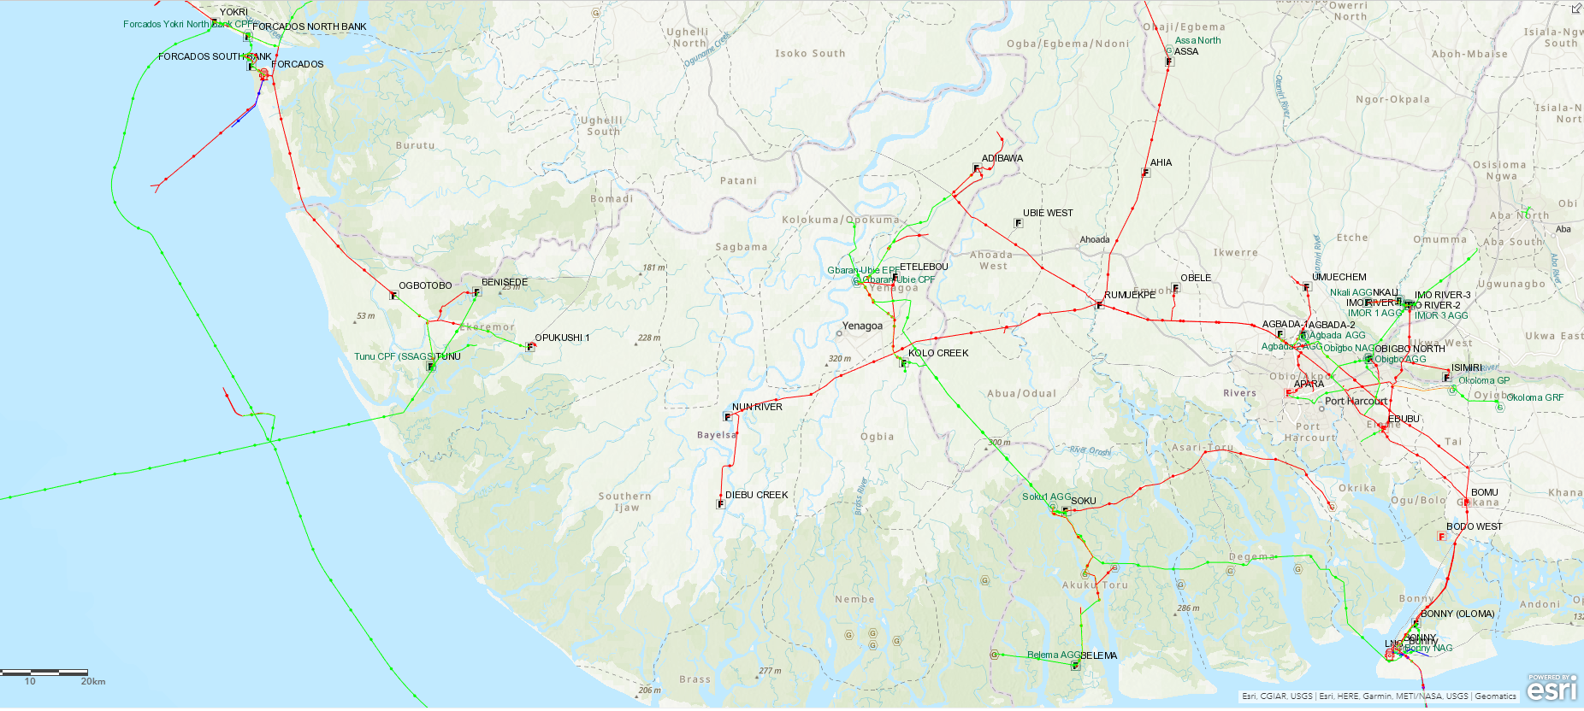
SECURITY Marine vessels (FOT/EA/BONGA/BOGT Overview)
FOT
Remarks
Steady State (1 year) – 11 (9 SPDC, 2 SNEPCO) ADHOC (<1 year) – 3 (1 SPDC, 2 SNEPCO)
S
S
ESTUARY
Ndoro
S
S
S
S
CLP
Tamuogbene
S
EA
S
S
S
S
BONGA
ILS
S
S
BOGT/CLP
S
S
S

Slide 7
Misaligned 2022 Security Demand Plan Vs Budget
DISCUSS
The security vessel demand for 2022 is $31.7m (9 steady state, 6 adhoc vesssels)
The approved security Budget for 2022 is $28m including $4.2m for EA ($20m for offshore vessels, $8m for others)
Budget for Logistics vessels will only cover circa 10 months for steady state & circa 3 plus months for one Adhoc vessel
Security Marine Common Cost Budget Performance for 2021 is $30.5m

Slide 8
DISCUSS
The demand is(4 vessels comprising 2 steady states and 2 ADHOC) for 2022 is $10.6m and is oversubscribing the allocated Security common cost budget of $9.3m.
The Budget will fully cover the year for the steady state vessels and 9 plus months for the ILS vessels

Slide 9
Decide on next step to manage misalignment
INFO
Budget offset from Assets (West/East) and supported functions (Wells/Project) –Approach Assets for budget offset and if secured, re-engage NAPIMS for alignment.
Optimize demand plan – Reduction in number of Security vessels in Forcados, EA and Bonny and Offhire ILS vessels for Bonga when not in use.

Slide 11
Budgeting for Marine common costs – challenges & way forward
PRE-READ
Current cost structure
DIRECT
CATERING
Budget build done at SAP Cost object level (Cost Centre/ WBS).
Cost object utilizes Unified Accounting Policy Code (UAPC)
Marine is 1 of up to 40 UAPC for selection.
Marine UAPC has 10 cost elements. Planner needs to dutiful and accurately reflect demand and rate in each element to capture Marine budget.
Horizontally, the budget is planned by the various functional planners.
Logistics as Marine contract holder defends the common cost budget
Logistics respond to demand utilizing the budget provided and subsequently defend cost performance
Marine Service Vessels
Log Marine Servs
HOTEL
SAP COST OBJECT
e.g.
O.NG.PTW.EXX.FAC.71300
Demurrage Ships
Marine Mtce Serv
MARINE UAPC
(with 10 cost elements)
HSE
MARINE
Charter Barges
Challenges
Under-budgeting of Logistics common costs by assets/functions.
Logistics common cost budget bears the brunt at the point of budget optimization.
Wrong/unfunded cost objects advised by assets for chargeback of Logistics cost during commitment control.
Legacy due to insufficient budget and contract ACV as PO can’t be issued
Charter Vessels
Standby Vesels
ICT
FUEL
Jetty Ops
MEDICAL
Supply Boat Servs
Harbour/Port Serv
Budgeting for Marine (common costs)
Proposed alternative structure – [all Budget under Logistics Team]
Budget Accountability for Marine Common Cost across SCiN sits with Logistics Manager Demands vs Approved Budget compared, Delta identified, scope aligned/budget offset with assets/planning. Logistics LCC process and PO creation Monthly joint BCC/showback to track spend and performance Customer Teams to engage Planning for alignment where Marine budget is sitting in Direct Cost Line prior to LCC approval/PO Creation. Logistics to Improve Optimization & Consolidation of Demands/improve utilization of Marine Resources across teams.
Benefits over current structure
Improved collaboration between Logistics, the asset and the asset finance BFU teams.
No PO, no work.
Confirmation of common cost budget availability prior to provision of service where chargeback cost objects are used to create POs
Effective and stringent commitment control with critical stakeholders involved

Slide 12
OP 21 MARINE BUDGET VS DEMAND VIEW 1

Slide 13
OP 21 MARINE BUDGET VS DEMAND VIEW (Cont’d)

